Slide 1
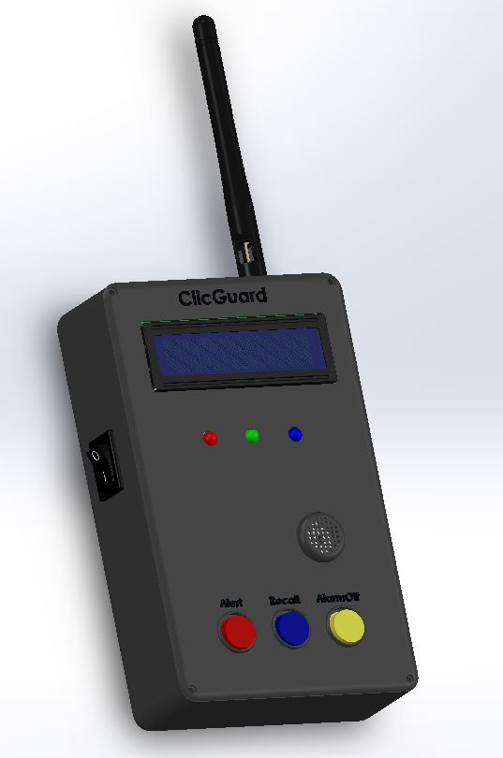
ClicGuard
An Emergency Alerting & Tracking Device

Slide 2
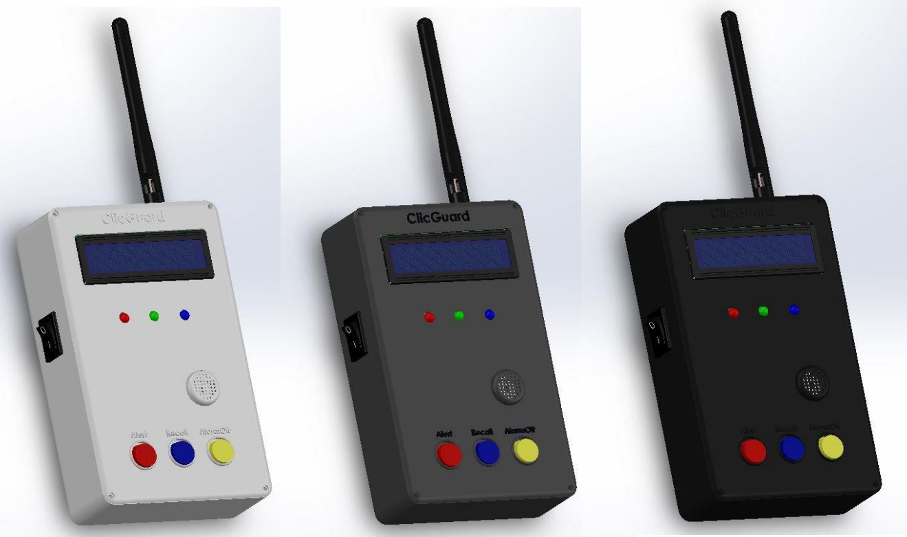
Description & Features
Two Modes
Emergency Mode
Tracking Mode
Good Battery life and Rechargeable
Encrypted and Safe
Broadcast Alerts & Tracking
Range 2 km in Open Space

Slide 3
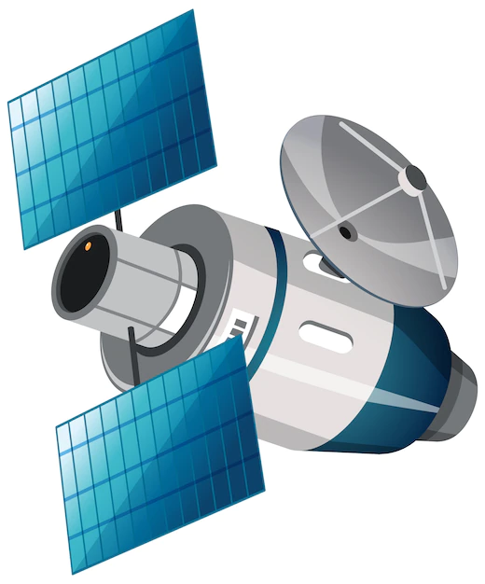

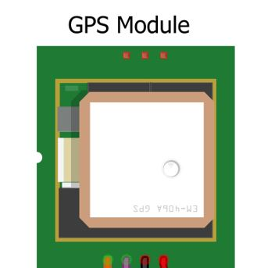
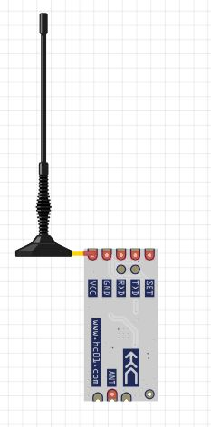


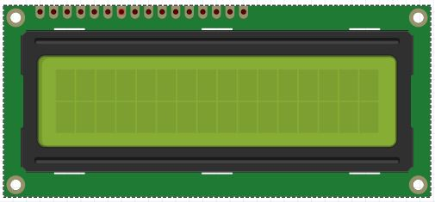
Functionality
Encrypted Broadcast
433.3MHz
2km
Transceiver
Transceiver

Slide 4
Encryption
Keys = [ 0.135, 0.235, 0.356, 0.456, 0.345 ]
Coordinates = [7.14546454 , 8.34035454 ]
Keys = [ 0.135, 0.235, 0.356, 0.456, 0.345 ]
Encrypted Coordinates = [7.38046454 , 8.749635454 ]
Transmitting Data = [7.38046454 , 8.749635454 , 0.135, 0.235, 0.356, 0.456, 0.345 ]

Slide 5
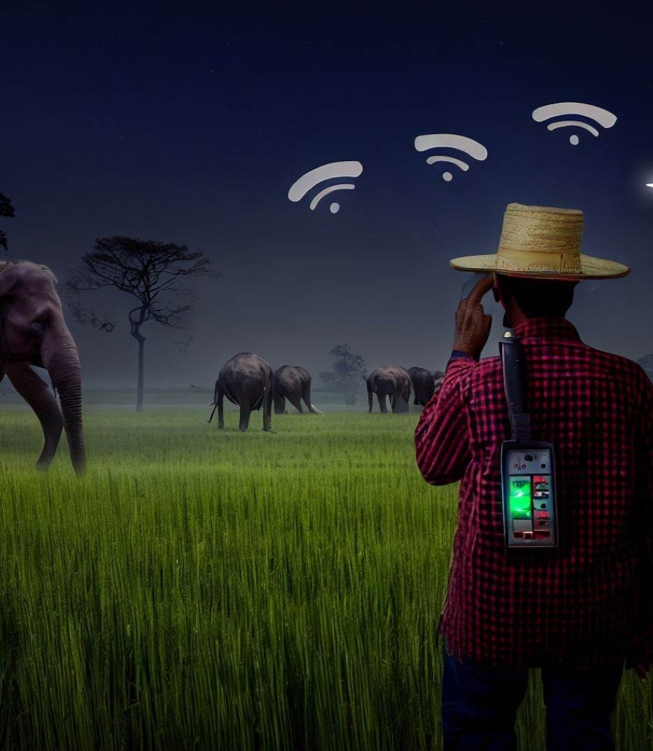
Application & Users
Outdoor Adventurers like Hikers and campers
Fishermen
Farmers living near Forest areas.
Villagers living near dangerous areas.
Forest Officers
Security Personnels / Security Guards
Elderly Vulnerable Individuals
Factories Workers
Event Organizing Security Teams

